Slide 1
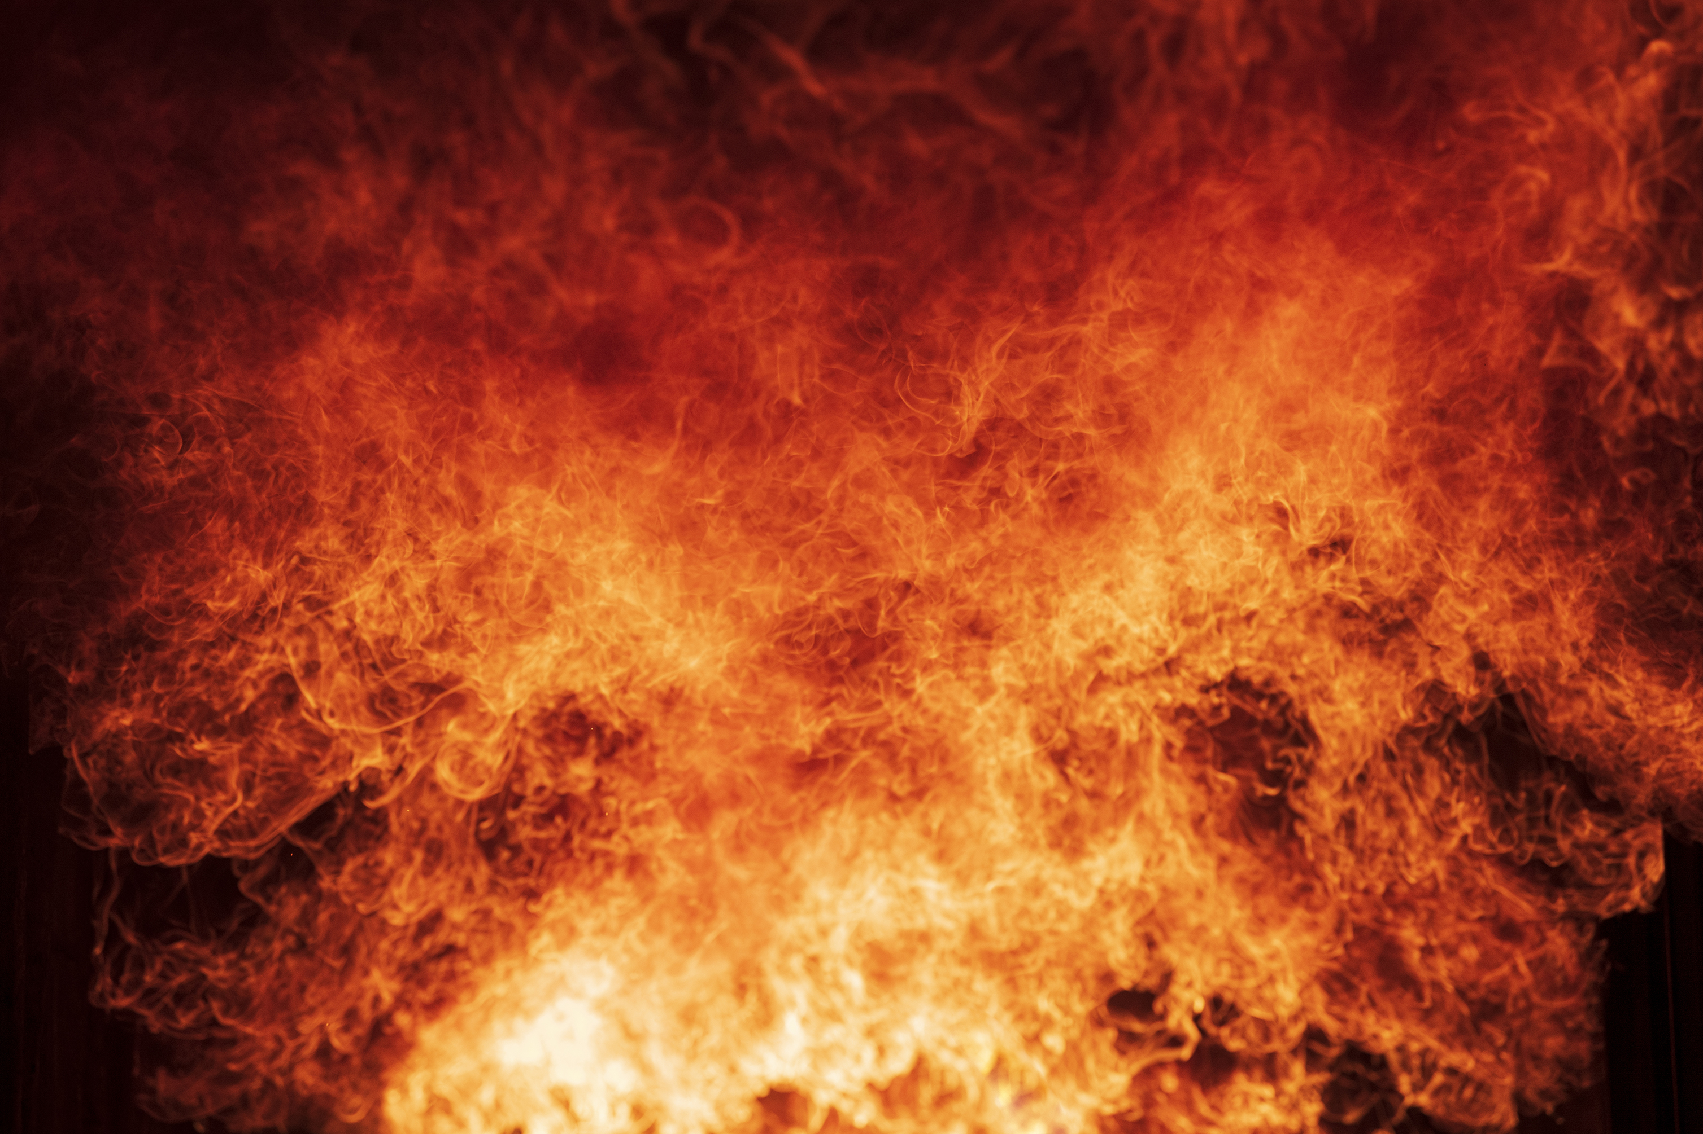


FIRE PLANNING
KURRAJONG HEIGHTS NEIGHBOURHOOD GROUPS
PROPERTY ADDRESS: xxx
Colour coding: Water in blue Hazards in red Access in green
Dam
Capacity
Access
Swimming Pool
Capacity
Water Tank
Capacity: ?l
Details of pump
Storz valve?
Gas Bottles
Location
House Sprinklers
Valve location
Pump arrangement
Solar Panels
Switch and solar controller location
Wood Pile
Location
Other Hazards
List
Additional Water Tanks
Capacity: ?l
Details of pump
Storz valve?
Other Water Items
Shed sprinklers
Fire pumps & hoses
Truck Access
Clearance 4m+ and driveway width 4m+
CUT AND PASTE AN IMAGE FROM GOOGLE MAPS TO REPLACE THIS PIC … OR DRAW A MUD MAP BY HAND
List water sources, electricity switchboards, gas bottles, fire fighting tools and materials & hazards. Place copy in Electricity Meter Box. Questions to kh.rfs.community@gmail.com
SHARE WITH YOUR NEIGHBOURHOOD COORDINATOR WHO WILL SHARE IT WITH THE RFS.

